Slide 1

BILLIONAIRES DATASET
Done by: Amangeldinova Kamila, Torekhanuly Abilkaiyr and Dairov Damir

Slide 2

CONTENT
Obtaining data
Scrubbing data/Cleaning our data
EDA (Explorative Data Analysis)
Conclusion

Slide 3
WHY DID WE CHOOSE BILLIONAIRE DATASET?
It seemed to us very interesting and helpful
in order to understand how to increase chances to become Billionaire

Slide 4

THE MAIN QUESTION THAT WE WANT TO EXPLORE IS
What are the factors that affect the total money of a billionaire?
How the :
country
category/industry
gender
age impact on having more finalWorth of a billionaire?

Slide 5
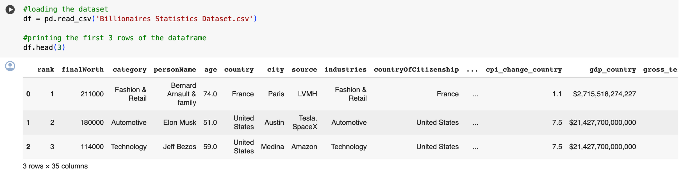
DATA OBTAINING
The Dataset was retrieved from Kaggle
link
Originally, the dataset was compiled from various sources, including Forbes and other financial publications

Slide 6

DATA CLEANING
Before : 2640rows X 35 columns
Check null data
Drop Null/Same Columns
Clean from Duplicates
Fill empty cell
After: 2640 rows X 13 columns

Slide 7
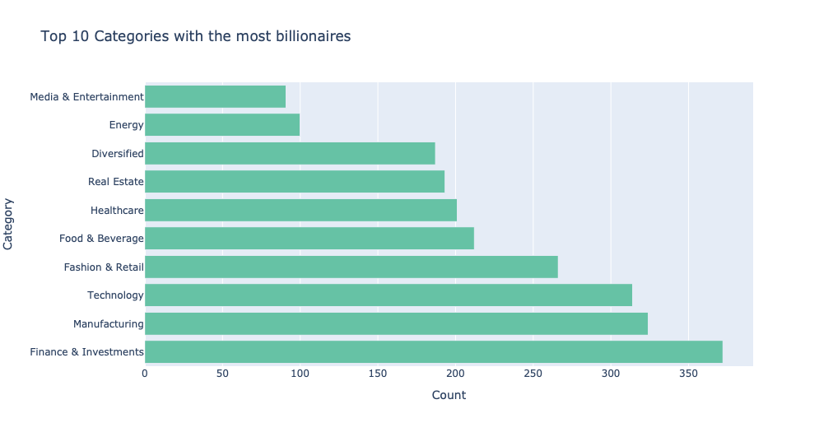

Slide 8
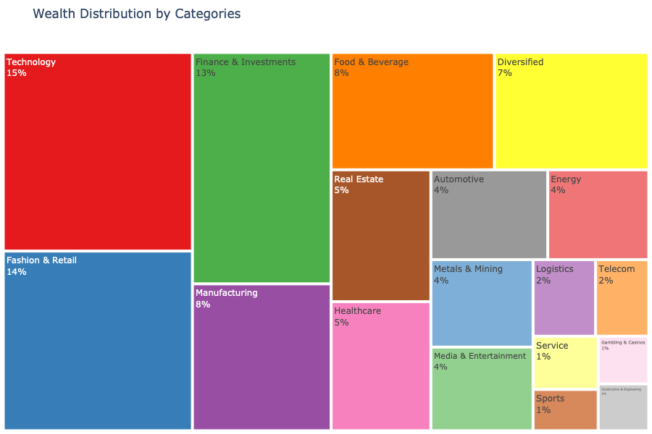

Slide 9
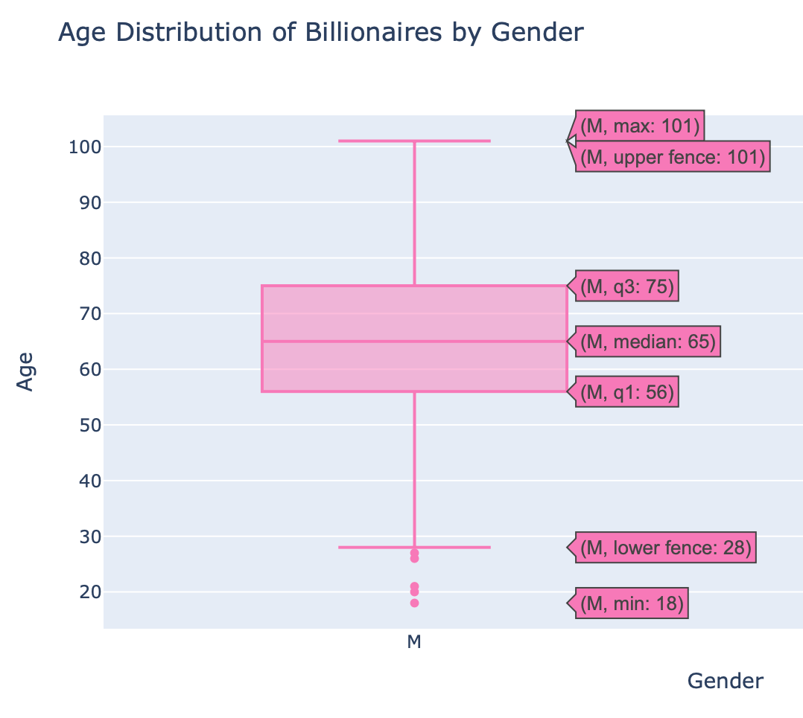
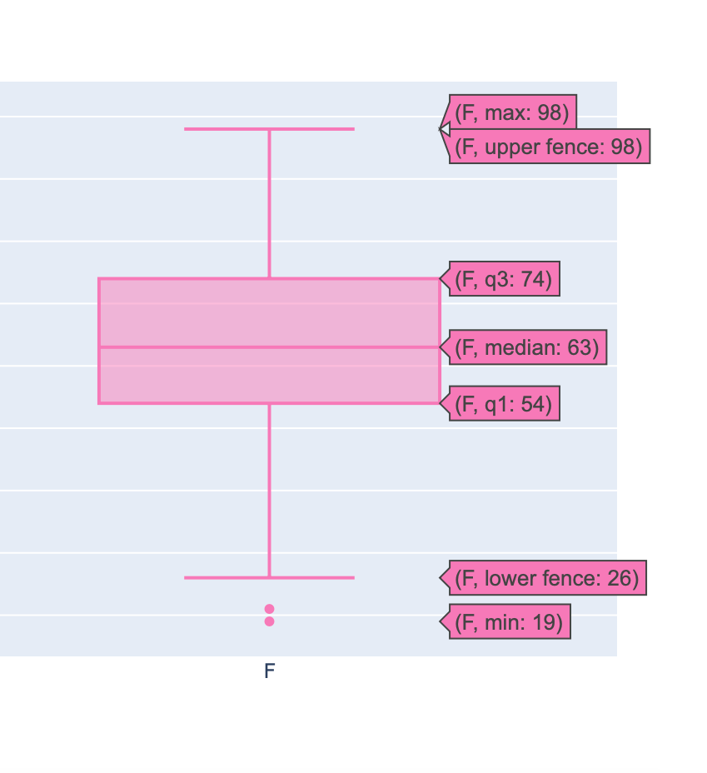

Slide 10
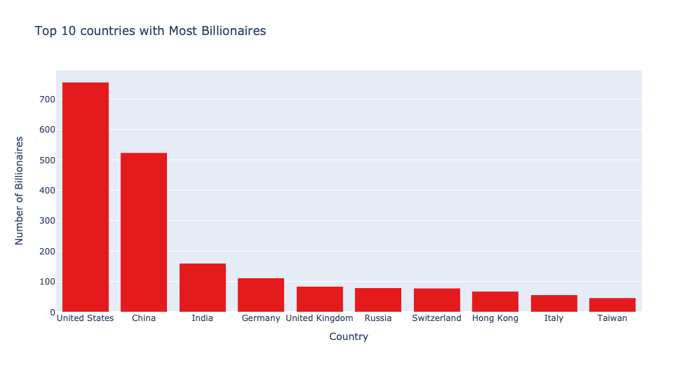

Slide 11
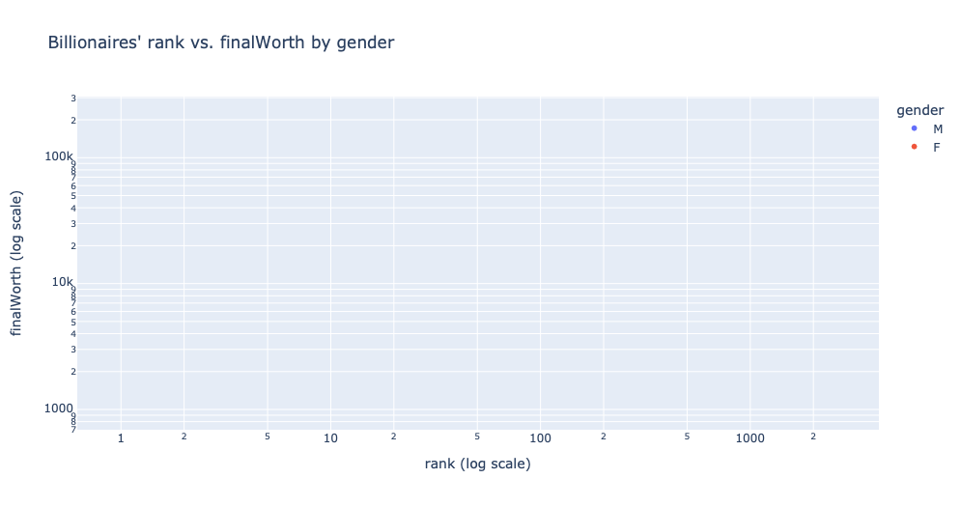
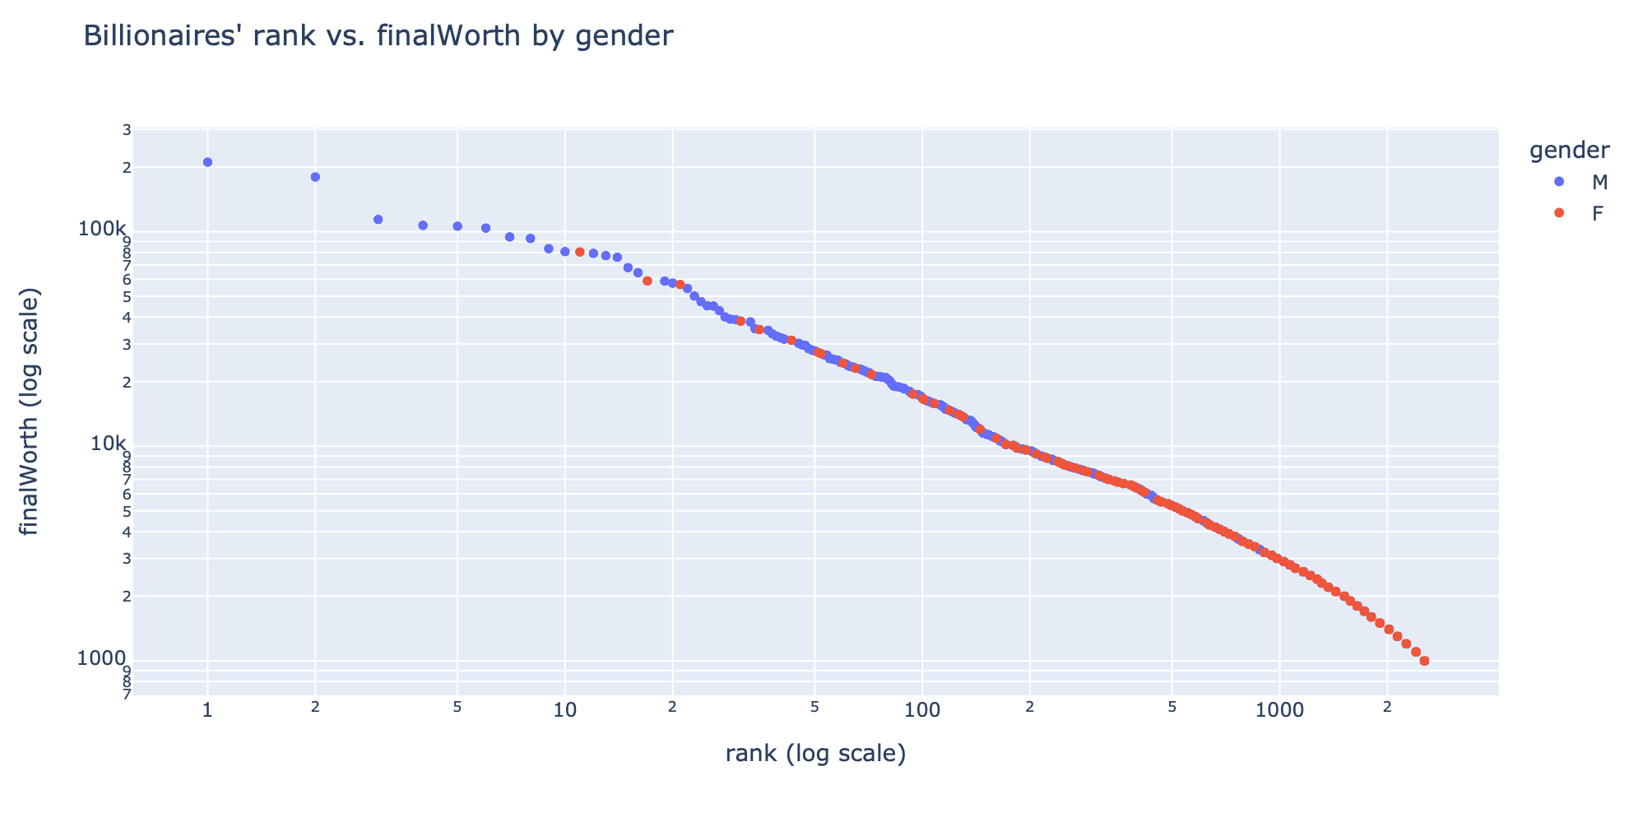

Slide 12
CONCLUSION
With the help of this analysis, we found common points between billionaires in order to build the portrait of a billionaire according to the dataset. On top of that, we defined the most wealthy industries and countries where most of the billionaires reside.
LEARN MORE

Slide 13
THANK YOU!

